Slide 1
Sexually Transmitted Diseases

Slide 2
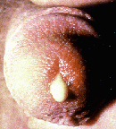
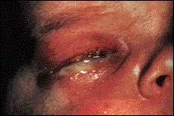
Gonorrhoea
Caused by the bacteria, Nisseria gonorrhoeae.
Males: may not have symptoms, pain when urinating, pus from penis.
Females: most do not get symptoms, may get discharge from cervix, may spread to uterus and fallopian tubes causing body-wide infection and infertility.
Babies: can be infected through the eyes during birth, may lead to blindness. All newborn get an antibiotic ointment put into their eyes immediately after being born.
Treated with antibiotics, though some strains are becoming resistant. Avoidance by abstinence or correct condom use during sexual relations is the surest way of avoiding this disease.

Slide 3
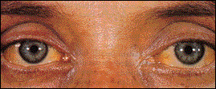
Hepatitis B
Hepatitis B is one of the causes of hepatitis.
Spread by infected body fluids
Damages the liver causing jaundice, flu-like symptoms, and ultimately liver failure.
Most people go into remission without any signs or symptoms, those who do not become progressively more ill.
No cure, but can be treated with antiviral drugs and a person can be immunised against Hepatitis B.
Abstinence or correct condom use will usually prevent transmission of this virus from one person to the next by sexual contact.

Slide 4
Hepatitis C
Hepatitis C is another virus that causes hepatitis.
Transmission by sexual contact is uncommon, more likely via blood.
Same symptoms as Hepatitis B, but fewer affected people go into remission and more become progressively ill.
Treatment with antiviral drugs.
Avoiding the risk behaviors (e.g., snorting cocaine, using IV drugs, and having unsafe sex with multiple partners) are the best preventative measures.

Slide 5

Chlamydia
In males: groin pain, burning on urination.
In females: vaginal discharge, may lead to infertility.
Unfortunately, many people are unaware they have the disease as it may have no symptoms.
Can be passed on to babies passing through an infected birth canal.
Caused by Chlamydia bacteria.
Treated with antibiotics, e.g.. Erythromycin.
Abstinence or correct condom use.

Slide 6
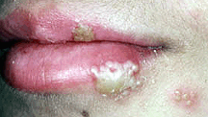
Herpes
Herpes is a common viral infection of the skin.
Herpes Simplex Virus – 1 causes mouth and lip rash.
Herpes Simplex Virus – 2 causes genital herpes.
Herpes is spread by skin-to-skin contact. Most exposure occurs when there is no identifiable rash.
Fever, headache, rash, muscle aches are the typical symptoms. These usually subsides after a few weeks.
Symptoms may recur from time to time as the virus lies dormant in the nerves.
Can be passed to babies during birth causing mental retardation, blindness and a higher than normal death rate.
No cure, but some treatment possible with antiviral medication.
Abstinence is the best form of prevention. Using condoms correctly and avoiding sexual activity when sores are present will significantly decrease the risk of infection, but will not entirely eliminate the risk.

Slide 7
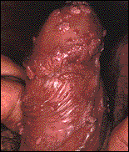
Genital Warts
Causes skin-coloured, cauliflower-like masses.
May lead to cervical cancer , in females.
Caused by an infection of the Human Papilloma Virus.
About 1/3 of all patient have spontaneous resolution.
Growths can be destroyed by medical treatment with liquid nitrogen, laser or acid.
Abstinence, and perhaps correct condom use may prevent transmission of this virus from one person to the next. It is crucial that all infected skin be covered to prevent skin to skin transmission. Since multiple areas of skin touch during intimate encounters, condom use is not terribly effective.

Slide 8
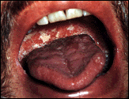

HIV/AIDS
The Human Immunodeficiency Virus (HIV) causes AIDS
Over time, the HIV virus weakens the immune system by infecting and killing certain white blood cells.
Most of the continual spread of HIV is caused by unprotected heterosexual sex, followed by homosexual sex, IV drug use, and transmission to a baby by an infected mother.
Treatment involves anti-viral drugs to slow HIV and antibiotics for treatment of the secondary infections.
Initially flu-like symptoms occur; requires a blood test for confirmation.
The most common opportunistic infections include fungal and bacterial diseases. The most common cancer associated with AIDS is called Kaposi's sarcoma .
Avoiding exposure to bodily fluids is the surest way to avoid getting HIV. Abstinence or correct condom use will prevent transmission.

Slide 9
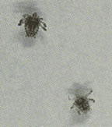
Pubic Lice
Caused by lice (Pediculus) and mites (Scabies). These are transmitted by personal contact, including sexual contact.
Both nymphs and adult lice feed on human blood.
Intense itchiness at the infected area is the most common symptom. Sometimes the crab louse can be seen moving within the pubic hair.
Treatment is with anti-parasite medication.
Avoiding contact with infected individuals is the best form of prevention. Correct condom use does not prevent crab infection because infected pubic hair and skin come into contact with one's partner’s pubic hair and skin.

Slide 10
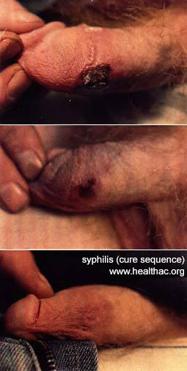
Syphilis
Caused by the bacteria, Treponema pallidum.
Has three stages if left untreated.
Primary: Chancres, open sores on genitals. Normally resolves without treatment.
Secondary: Rash, fever, sore throat, swollen glands.
Tertiary: May occur years or decades after initial infection. Bacteria invade and damage the nervous system (causing mental illness and paralysis) and heart.
Can be passed from mother to child. Babies may be born with symptoms similar to tertiary syphilis.
Antibiotics are used to treat every stage of this illness. This usually cure the disease in the first two stages.
Abstinence or correct condom is the key to avoiding this disease. As any skin exposed to a chancre or other syphilitic rash can become infected, condoms are not always effective.

